Slide 1
Codes and Texts @ Codecamp
41. Open X-Day 30.10,2020

Slide 2
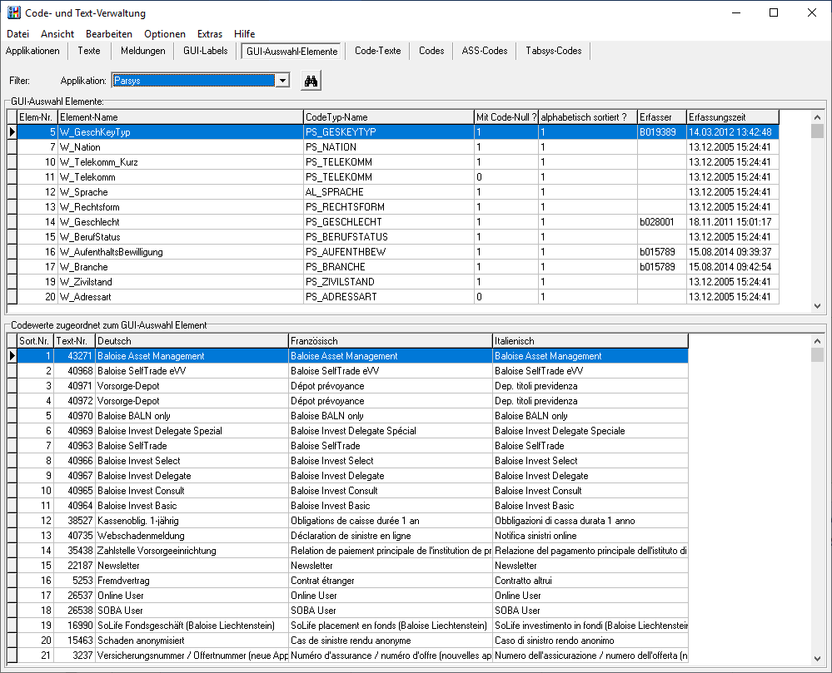
Background: Code- und Text-Verwaltung @ Baloise
Delphi-Client with data on DB2 Host
Local installation
ODBC driver
Admin rights
Data administration via UI
Performance low
Connections unstable
Source code generation via UI
Not easy to adapt for new technology
Raw data would be easier for some

Slide 3
Codecamp 2019: codes-and-texts prototypes
cat-server
SpringBoot application
Read data from PostgreSQL DB
Expose data via Rest API
cat-client
Angular client connecting to mock DB
cat-vaadin-client
Vaadin client connecting to mock DB
Supports applications, domains, codetypes
cat-generator
Connect to Rest-API from cat-server
Create CuT-compatible code from json

Slide 4
Codecamp 2020: codes-and-texts fill the gaps
cat-server
Deployable to Baloise incubator OpenShift
Security using KeyCloak
cat-client
cat-vaadin-client
Connect to cat-server
Support also Texts
cat-api (cat-adapter)
Connect to Rest-API from cat-server
Download json as file or use as service
Provide simple API for codes and texts

Slide 5
Codecamp 2020: Vaadin Client Demo
https://cat-vaadin.apps.baloise.dev/
User: admin / Pass: admin

Slide 6
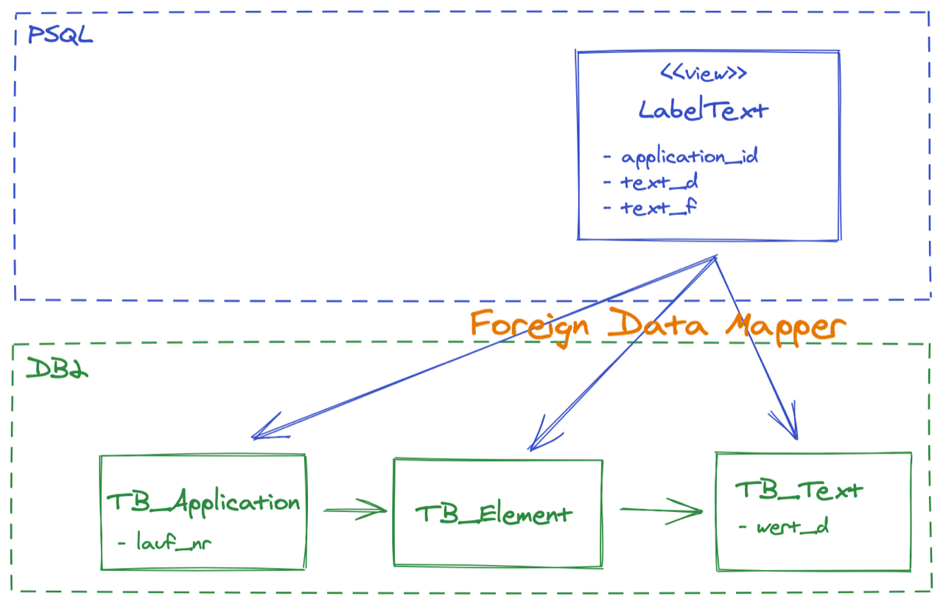
Codecamp 2020: backend/persistence

Slide 7

Codecamp 2020: backend: the new API
https://cat-server.apps.baloise.dev/swagger-ui/index.html

Slide 8







Codecamp 2020: deployment
frontend
backend
backend
frontend
postgres

Slide 9
Appendix A: CuT DB Modell (simplified)
element
(W, 2)
codeelement
applikation
coderef
codewert
codetyp
zustaendig
element (LBL, 1)
text
codetext
codetextstil
meldungsstil
meldungsref

Slide 10
Appendix B: CaT prototype views
application
(messagetext)
codevalue
codetype
domain
labeltext
text
codetext
(codestyle)

